Slide 1
Project title: Flight Ticket Booking System
Submitted By:
ISHIKA JAGGI
Roll No-
2100290100073

Slide 2
Abstract
The project aims to design Flight Ticket Booking system which will provide customers a facility to reserve there tickets without any hassle. The air ticket reservation system designed in this project was developed using java as the programming language. This system allows real time communication between admin and user.This system allows the airline passengers to search for flights that are available between the two travel cities, namely the “Departure city” and “Destination city” for a particular departure and arrival dates. The system displays all the flight’s details such as flight number, name, price and duration of journey etc. After search the system display list of available flights and allows customer to choose a particular flight. Then the system checks for the availability of seats on the flight. Then it book the flight.

Slide 3
Objectives
To make air ticket reservation easier for passenger.
To save time and effort of potential air traveler.
To reduce the hassle of the user.

Slide 4
Introduction
Online Flight Ticketing is a kind of user assistance where customers can reserve tickets for flight in online. This is an easy method which saves a lot of time. This project entitled design and implement of an air ticket reservation system can be applicable to any airlines. The feature of this system will be similar as a common ticketing system. As a user :
You can view the schedule
You can reserve ticket
You can cancel your reservation
You can confirm your reservation

Slide 5
About Java :
Java is a high-level programming language and is platform independent.
It was first developed by Sun Microsystem.
There are huge application java language and one of them which we are discussing is flight booking system.

Slide 6
Java Program:
In the java programing language , all source code is first written in plain text files ending with the java extension.
Those source files are then compiled into .class files by the java compiler.
We started creating the project with making flight.txt file which will store the details(i.e name of source to destination, total number of seats , available and unavailable , price etc.)

Slide 7
About user and admin:
1. Admin:-
Admin can check the booking records of users.
Admin can change the status of booking.
Admin can add , delete and edit new flight details.
2.User:-
User can search new flight by entering the light name from and to for eg. Delhi to Kerala.
User can register in the application with id and password.
Then user can book tickets by entering his/her details and book the available seat.

Slide 8
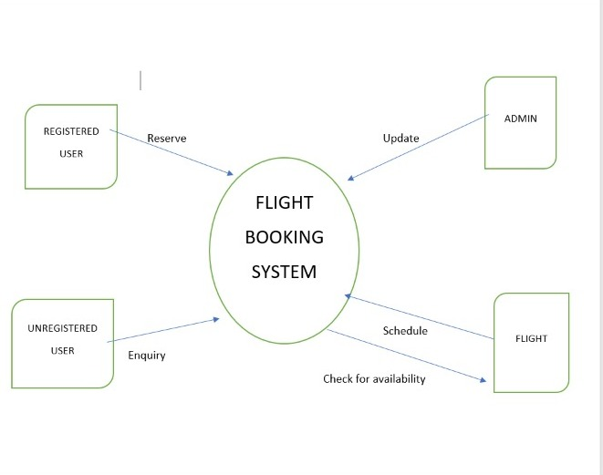
Data Flow Diagram

Slide 9
Types of User:-
ADMIN:
Creating a flight
Changing time schedule
Creating a new route
Updating airport information
Registering and managing users
View statistics
REGISTERED USER:
View flight schedule
Book, confirm/cancel reservation
UNREGISTERED USER:
View flight schedule

Slide 10
Details of the technical learnings during the delivery of task :
We were able to learn a great deals of topics and skills while the completion and the delivery of this task and the list of the skills learned are as follows :
Getting started with Java Development.
Java Programs and Classes.
Objects, Data and Methods.
Conditional and Loops.
Concepts of Object-Oriented Programming.

Slide 11
OBJECT-ORIENTED PROGRAMMING is a programming paradigm based on the concept of “objects”, which can contain data and code: data in the form of fields, and code,in the form of procedures.
The four pillars of object-oriented programming are :
ABSTRACTION
ENCAPSULATION
INHERITANCE
POLYMORPHISM
And various other topics and skills to complete the entire project.

Slide 12
1. ABSTRACTION: It is the process of taking away or removing characteristics from something in order to reduce it to a set of essential characteristics. In OOP, in the process of abstraction a programmer hides all but the relevant data about an object in order to reduce complexity and increase efficiency.
2. ENCAPSULATION: It is a way to restrict the direct access to some components of an object, so users cannot access state values for all of the variables of a particular object. It can be used to hide both data members and data functions or methods associated with an instantiated class or object.

Slide 13
3. INHERITANCE: It is a mechanism where you can derive a class from another class for a hierarchy of classes that share a set of attributes and methods.
4. POLYMORPHISM: It is one of the situtation in which something occur in several different forms. In computer science, it describes the concept that you can access objects of different types through same interface.

Slide 14
Technical Requirements
Registration
Login
View schedule /Reserve ticket
Searching flight schedule
Uploading Information into the system

Slide 15
Advantages
PRICES: Going to the nearest travel agent will cost you their booking charges,but by flight ticket booking online you can gain access to cheap fare prices without the need to pay an additional booking to your agent.
Rescheduling and Cancellation: You have freedom to make changes to your flight and reservation.
Convenience: One of the best perks you can enjoy while booking your flight tickets online is the ability to book it wherever you are. You can book it from the comfort of your own room or office through your phone or laptop without the need to go out and do so from nearby agent.

Slide 16
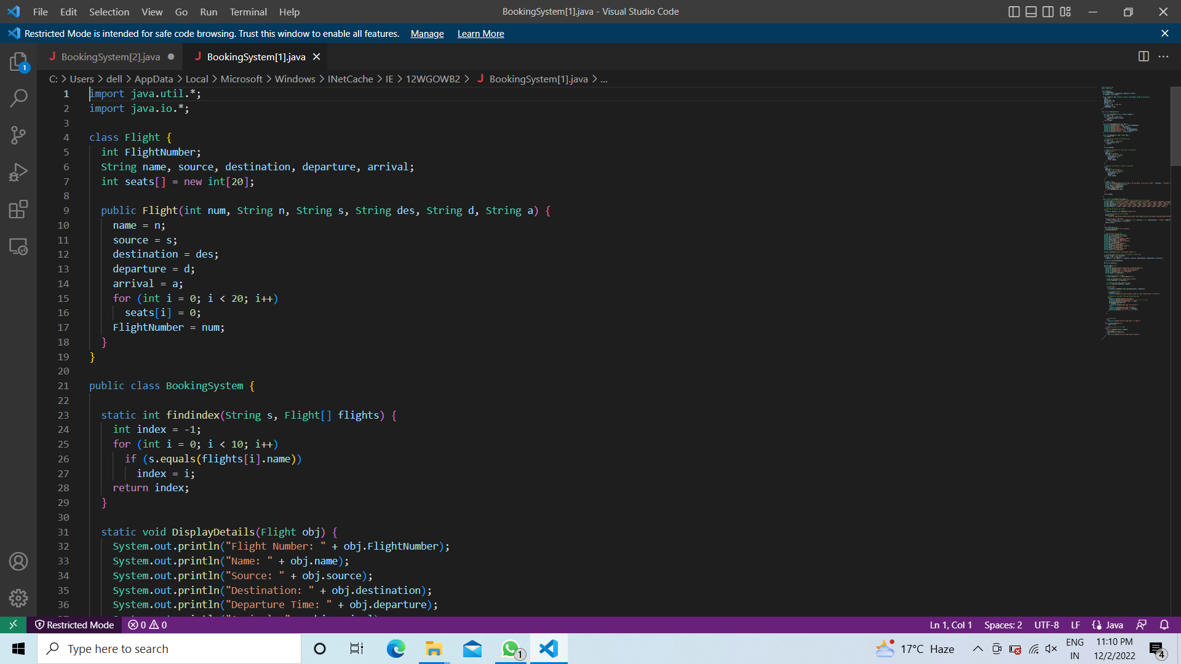
Screenshot of the code

Slide 17
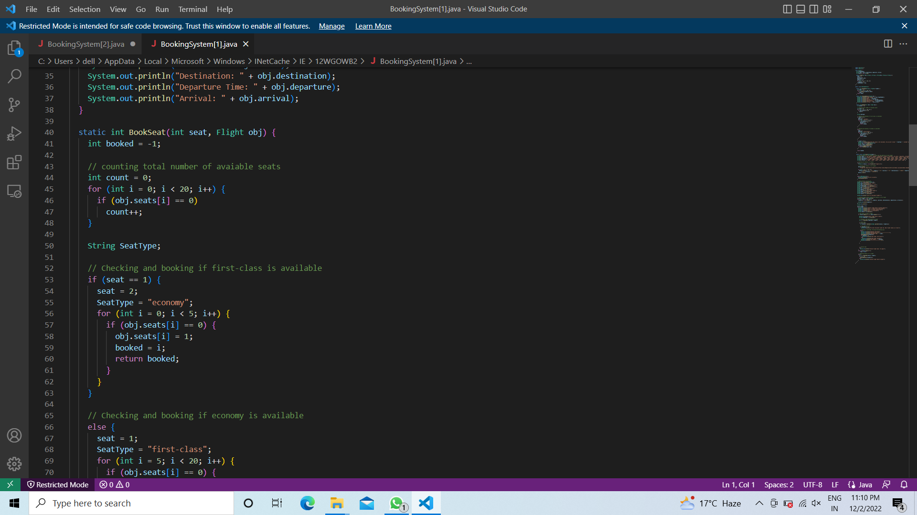

Slide 18
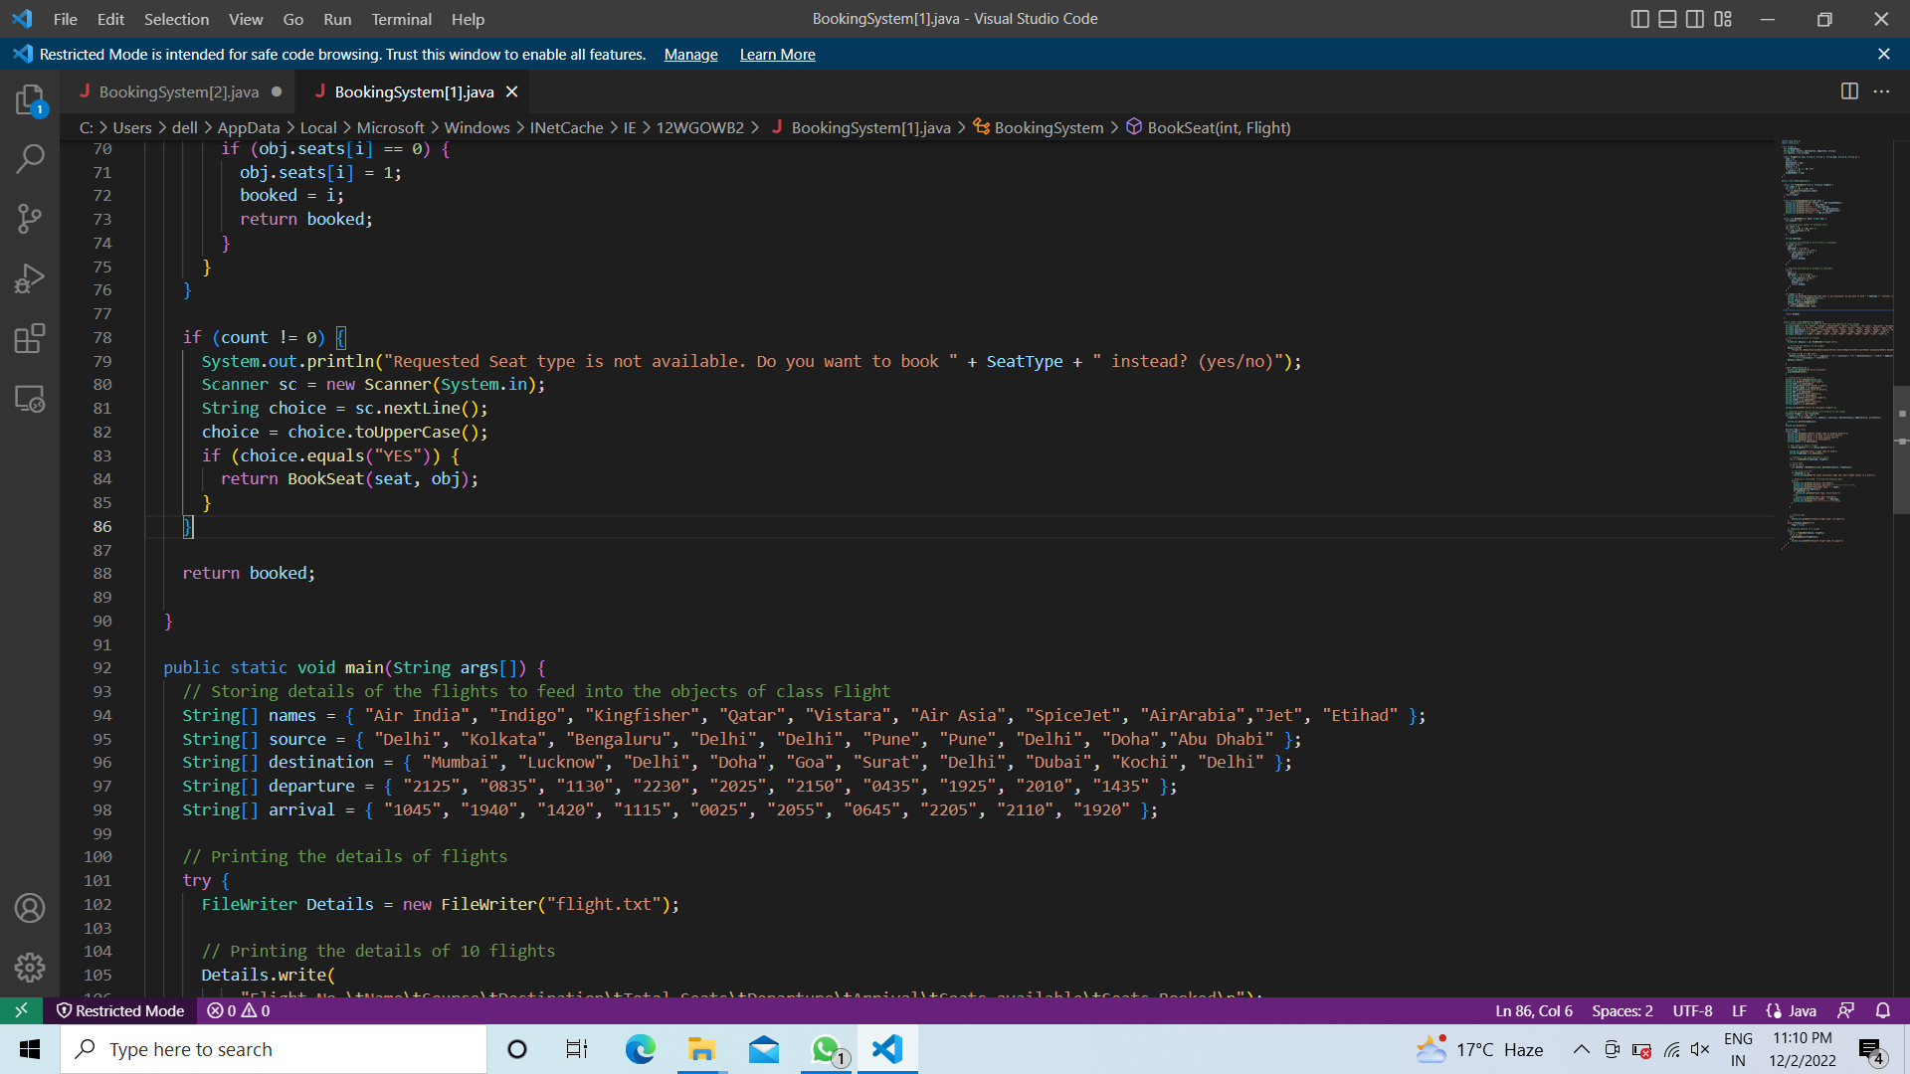

Slide 19
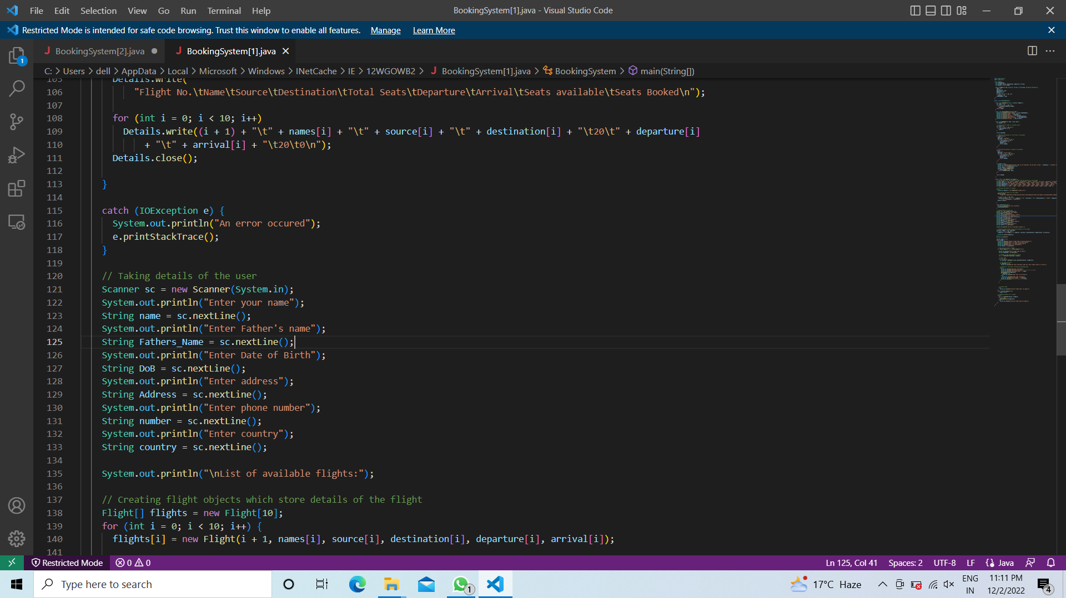

Slide 20
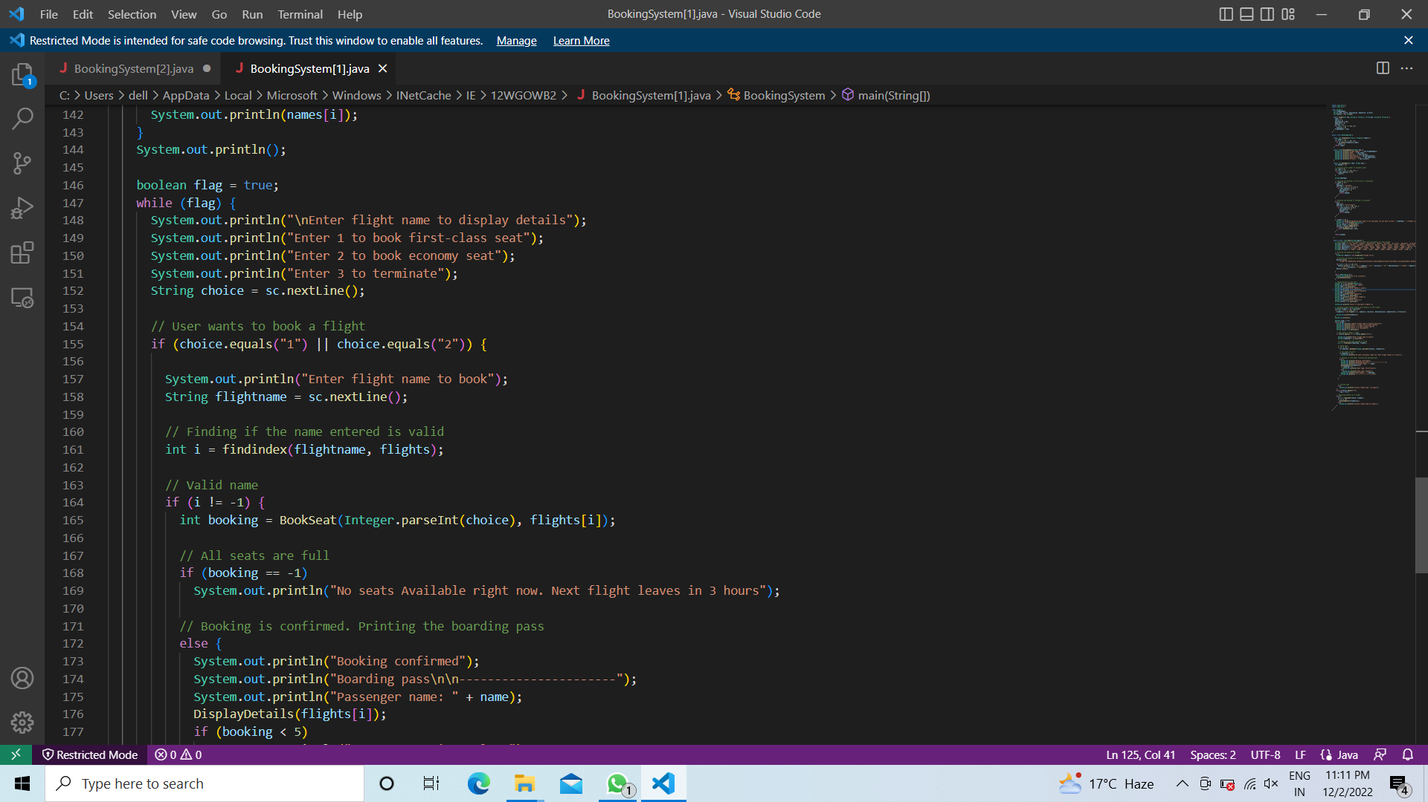

Slide 21
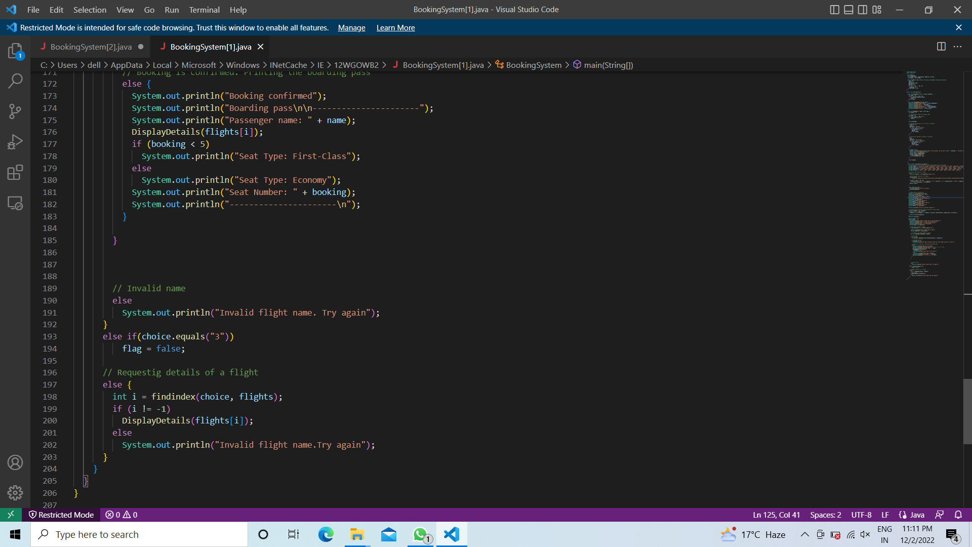

Slide 22
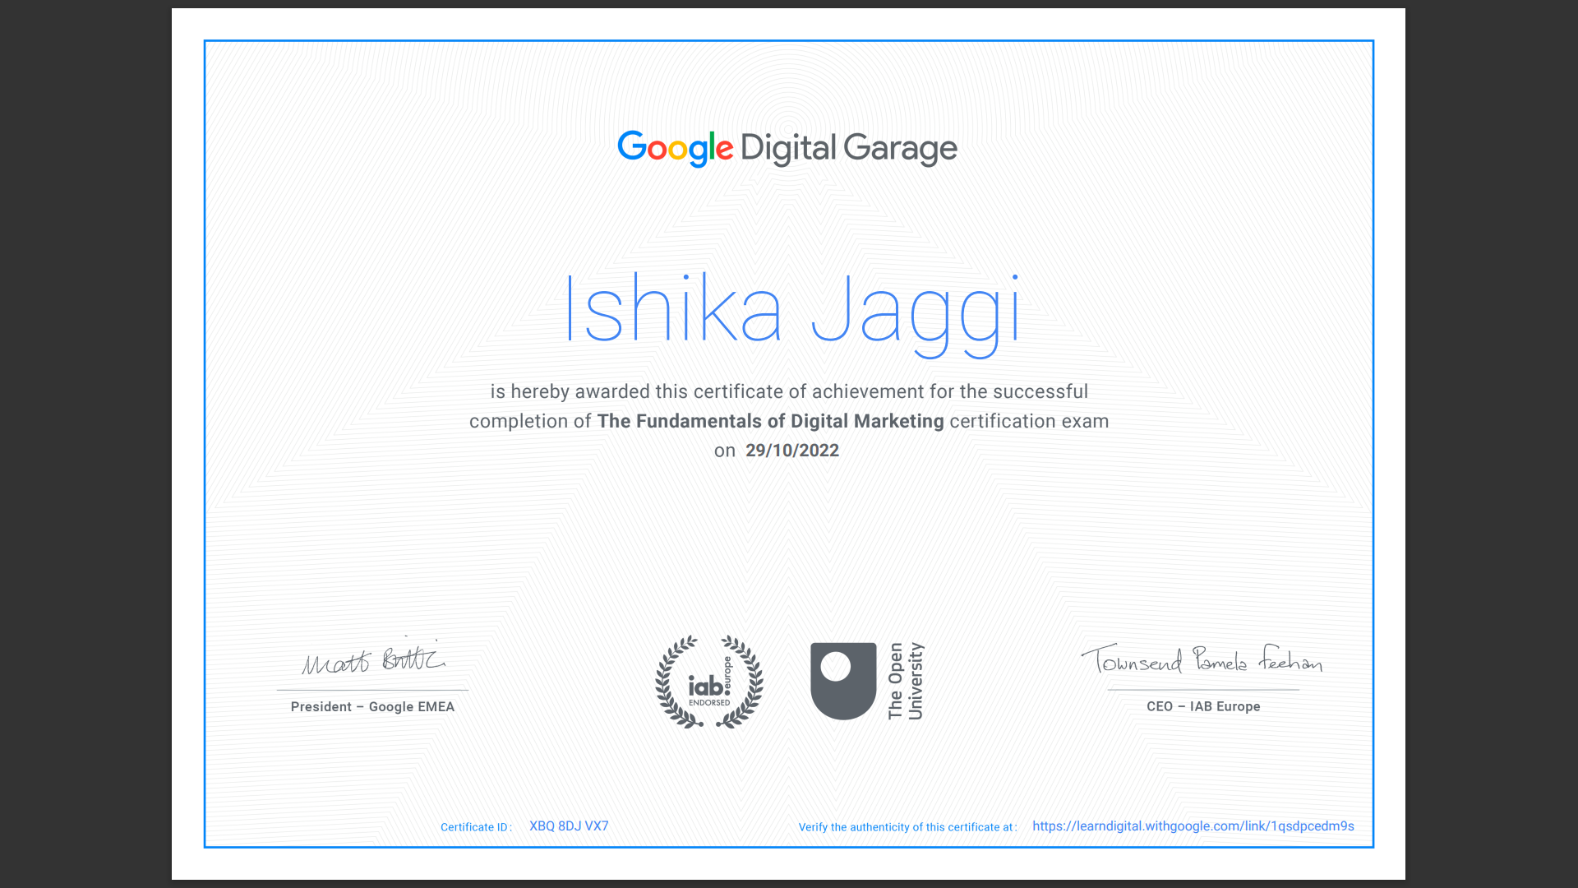
MOOC CERTIFICATE

Slide 23
Conclusion
The online flight ticket reservation automates the process of booking airline tickets, thus reducing the time wasted as well as the errors that are involved in the manual process.In this project we had to think about the various options which we can provide to user. We have tried to make this project user friendly and also interactive by providing many features.

Slide 24
THANK YOUU !!

